Slide 1
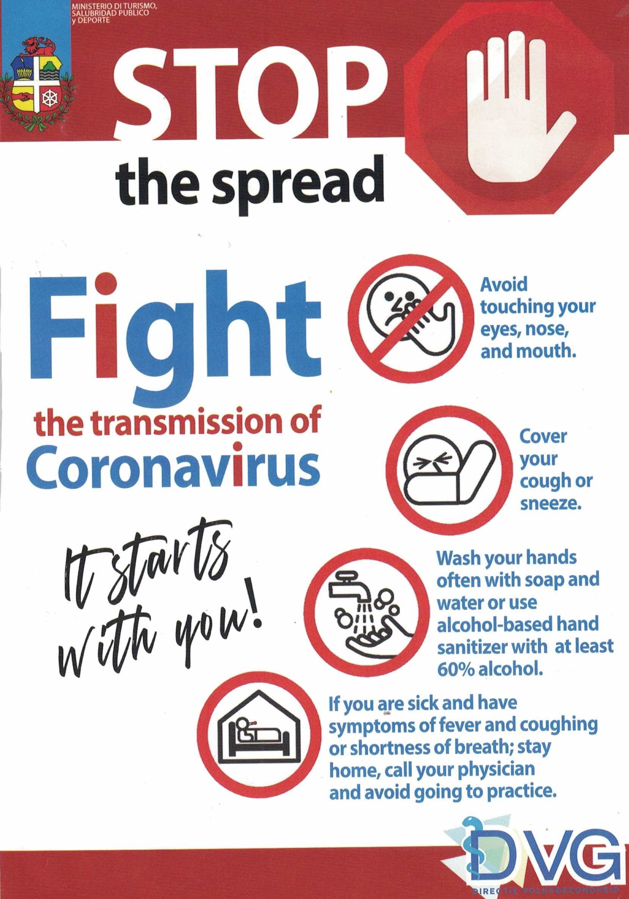
SAFETY PROTOCOLS
We are looking forward to having a great off-road adventure with you! If you have upcoming trips with Action Tours or are thinking about booking a trip in the near future, we are confident that you will feel much more at ease knowing that Action Tour team is committed to making your trip safe and fun!
For your safety and for the safety of others, if you are feeling unwell, we offer flexible cancellations with your prompt refund.

Slide 2
SAFETY PROTOCOLS
Transportation - pick-up and drop off:
Tour guides and drivers are wearing face shields
Social distance of a least 1.5 to 2 meters in between each household and other guests and staff
Hand sanitizers available in all transportation vehicles
Each transportation vehicle are sanitized before and after each transfer
Antibacterial and disinfecting spray/wipes are available at transportation vehicles
Assigned seating areas on transportation vehicles
Check-in:
For your safety we have implemented an outdoor checking area with comfortable seating and social distance arrangements
We have increased the frequency of disinfecting surfaces and high traffic areas during and between each tour.
We have implemented a sanitizing area with sanitizing dispenser, soap dispenser and water faucet (hands free) for your convenience.
Precautionary signage to prevent Covid spread
During the Tour:
All vehicles are cleaned after each tour
Disinfectant sprays/wipes available to disinfect vehicle handlers and other areas.
Our staff wears mouth covers and goggles during the tour.
Mouth covers and goggles are available for sale prior to tour departure.
Tour capacity is limited to maximum 7 vehicles to avoid crowds.
Social distance of 1 ½ - 2 meters are observed during tour

